Slide 1
A Study Of The Book Of Revelation
May 24, 2020

Slide 2
Revelation 2:1-7
“Letter to the Church at Ephesus”
The Church that Left its First Love
Identification of the Author (verse 1)
Commendation (verses 2-3, 6)
Condemnation (verse 4)
Plea to Repent (verse 5)
Promise if Overcome (verse 7)

Slide 3
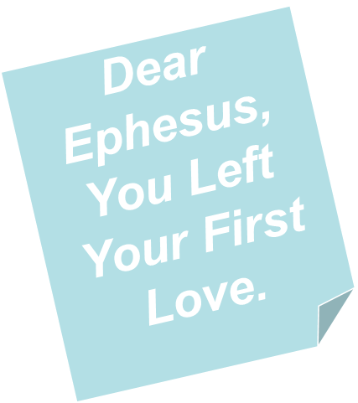

Revelation 2:1-7
“Letter to the Church at Ephesus”
The Church that Left its First Love
Key Verse
Revelation 2:4
“Nevertheless I have this against you, that you have left your first love.”

Slide 4
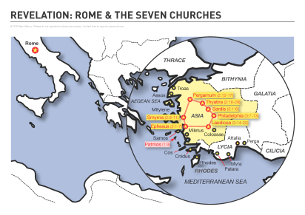
E
P
H
E
S
US
Third largest city of Roman empire.
Population 250,000.
One of the greatest seaports in the ancient world.

Slide 5
Revelation 2:1-7
Lord Sees and Knows It All
Verse 1: “To the angel of the church in Ephesus write: These things saith he that holdeth the seven stars in his right hand, he that walketh in the midst of the seven golden candlesticks.”
What is said (good / bad) is stated by one who hold the destiny of the church in his hand.
Lord has full knowledge of the inter-workings of this church!

Slide 6
Revelation 2:1-7
A Church That Left Its First Love
When the Fire is Gone
Its History.

Slide 7
Revelation 2:1-7
Its History
Paul Visited Ephesus Briefly on 2nd Journey (Acts 18:18-21)
Aquila and Priscilla Corrected Apollos (Acts 18:24-28)
Conversion of 12 Previously Baptized (Acts 19:1-7)
Many Converted on 3rd Journey (Acts 19:8-20)
In midst of controversy (verses 8-16)
Burned their books (verses 18-19)
Stayed three years (Acts 20:31)

Slide 8
Revelation 2:1-7
Its History
Idol Craftsmen Caused a Riot. (Acts 19:21-41)
Paul Met with Elders at Miletus. (Acts 20:13-38)
May have Visited Again after Prison. (1 Timothy 1:3)
Paul Wrote a Letter to the Church at Ephesus (Ephesians).
Timothy Worked with the Church (1 Timothy 1:3).

Slide 9
Revelation 2:1-7
A Church That Left Its First Love
When the Fire is Gone
History
Its Strong Qualities

Slide 10
Revelation 2:1-7
Its Strong Qualities
A. Works (verse 2)
1. What they do in service to the Lord.
2. “Works may be either good or bad; here they appear to be good” (Hailey, 121)
3. This is an active congregation

Slide 11
Revelation 2:1-7
Its Strong Qualities
A. Works (verse 2)
B. Labor (verse 2)
“Toil” (ESV, ASV)
Strenuous, wearying labor
“Toil lies deeper than works. The word translated toil has reference to the effort that produces work at the cost of pain” (Ray Summers, 109)
This is an aggressive church.

Slide 12
Revelation 2:1-7
Its Strong Qualities
A. Works (verse 2)
B. Labor (verse 2)
C. Patience (verses 2-3)
Persistence in the toil – staying when the burden is heavy
Didn’t “give up when things went bad, or when someone criticized, mocked, or ridiculed them” (Harkrider, 26)
This is a determined church

Slide 13
Revelation 2:1-7
Its Strong Qualities
A. Works (verse 2)
B. Labor (verse 2)
C. Patience (verses 2-3)
D. Doctrinally Correct (verses 2, 6)
Cannot bear evil men (verse 2)
“The evil men were detected, convicted and expelled” (Foy E. Wallace, Jr., 86)
Exposed false apostles (verse 2) 2 Corinthians 11:13
Hated deeds of the Nicolaitans (verses 6, 15) 1 John 4:1; 2 John 9-11; Romans 16:17-18; Titus 3:10-11

Slide 14
Revelation 2:1-7
Its Strong Qualities
A. Works (verse 2)
B. Labor (verse 2)
C. Patience (verses 2-3)
D. Doctrinally Correct (verses 2, 6)
What could be wrong with such a church?

Slide 15
Revelation 2:1-7
What could be wrong with such a church?
“This entire commendation leaves one inclined to question if there could be anything wrong in such a church. It carried on its service in the face of difficulties; it rejected false teachers; it hated sin; it did not grow weary in the Lord’s work.”
Ray Summers, 110

Slide 16
Revelation 2:1-7
A Church That Left Its First Love
When the Fire is Gone
History
Its Strong Qualities
Its Problem

Slide 17
Revelation 2:1-7
III. Its Problem
“left your first love”
A. Place of Love
1. Love is essential
a. Love God (Matthew 22:37)
b. Love Truth (2 Thessalonians 2:10-12)
c. Love One Another (Romans 13:8)

Slide 18
Revelation 2:1-7
III. Its Problem
“left your first love”
A. Place of Love
1. Love is essential
2. Love produces action
a. Context (verses 4-5)
b. Galatians 5:6 – faith works by love
c. 1 John 5:3 – love of God – keep commands

